Slide 1
Capstone Project A Reasonable Location for a New Bookstore in Greater Melbourne
By Fendy Gao
Date: 2020-AUG-15

Slide 2
Table of Contens
Problem Description
Data
Data of Greater Melbourne
Data of Bookstores
Methodology
Process Data of Greater Melbourne
Process Data of Bookstores
Machine Learning
Results
Discussion

Slide 3
Problem Description
Melbourne is the capital and most populous city of the Australian state of Victoria, and the second most populous city in Australia, where I am living. The area of Greater Melbourne area is about 9,993 km², with a metropolitan area with 31 municipalities. It has a population of about 5 million.
One of my favorite shopping places is bookstore. Due to the impact of on-line sales and electronic publications, it gets more and more difficult to access a regular bookstore now. However, a bookstore is still a very nice place for adults to have some readings and for children to have some learnings. Hence, in this study, I focus myself on bookstores.

Slide 4
Problem Description
To setup a bookstore would be determined by multiple factors, such as population, transportation, rental rate and etc. Also the existing numbers of bookstores in a certain region would be also important. I would like to focus on the factors in the population side. Hence, I'd like to collect data about the number of bookstores in each sub-region of Greater Melbourne Area, the bookstore number vs. population, the accessibility of bookstores to each sub-region, and etc. With all these data analyzed using machine learning technologies, I should be able to yield a recommendation for a location to setup a new bookstore.
In summary, in this project, a study was performed to determine a reasonable location (or locations) to setup a new bookstore (bookstores) in the Greater Melbourne area.

Slide 5
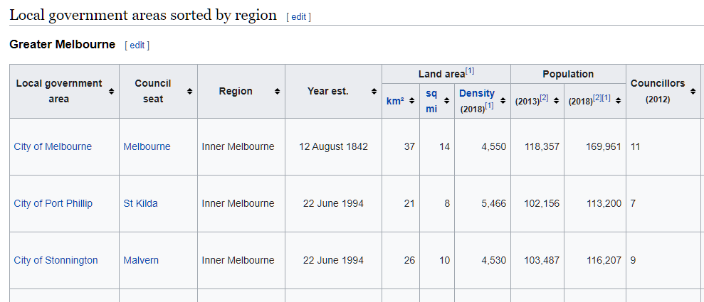

Data of Greater Melbourne
https://en.wikipedia.org/wiki/Local_government_areas_of_Victoria

Slide 6
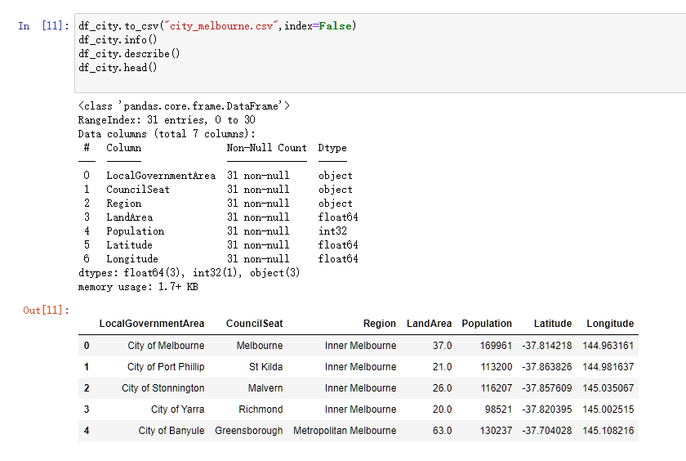
Data of Greater Melbourne

Slide 7

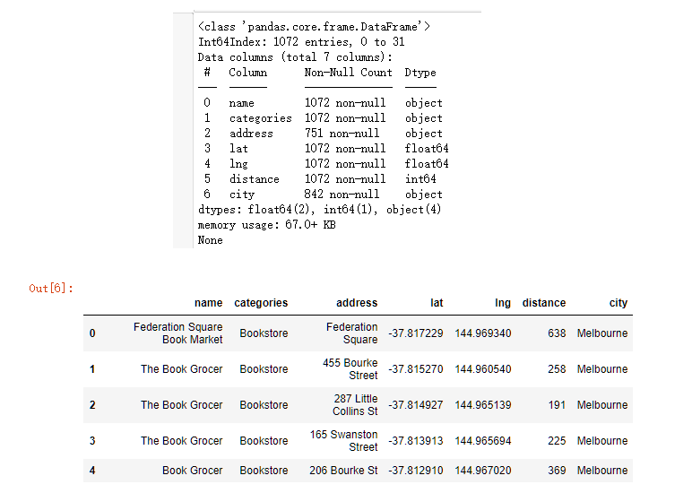
Data of Bookstores

Slide 8
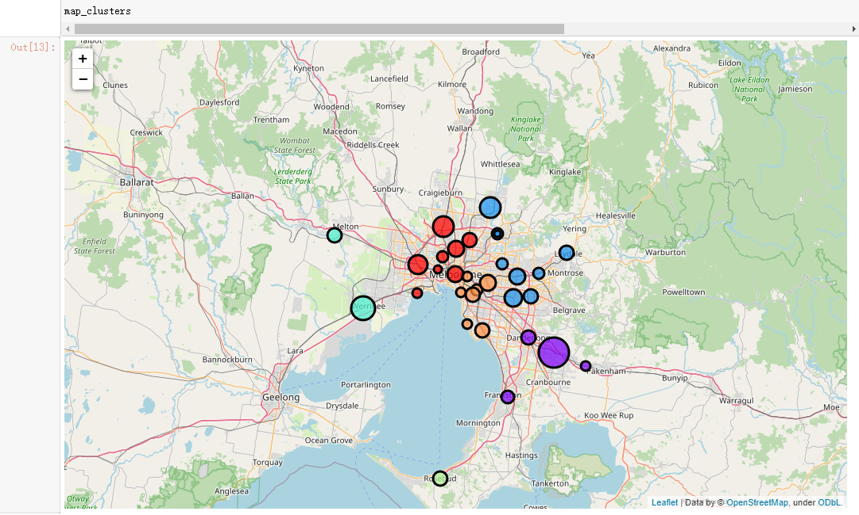
Population in Greater Melbourne

Slide 9
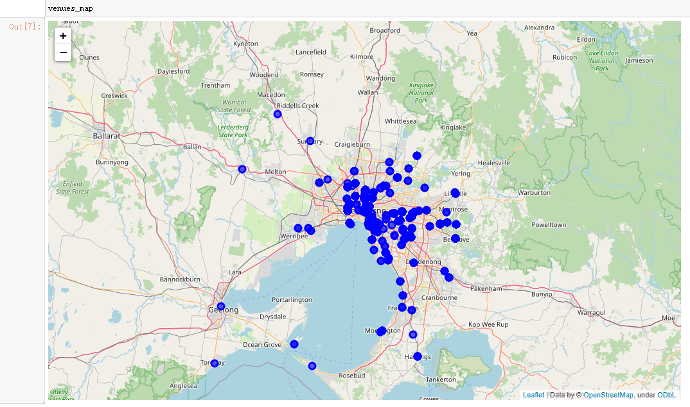
Bookstore locations

Slide 10
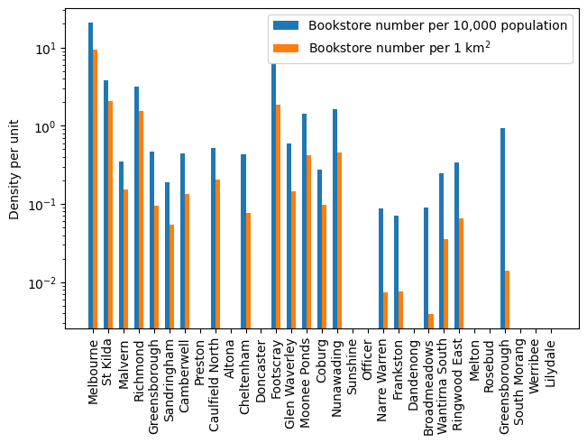
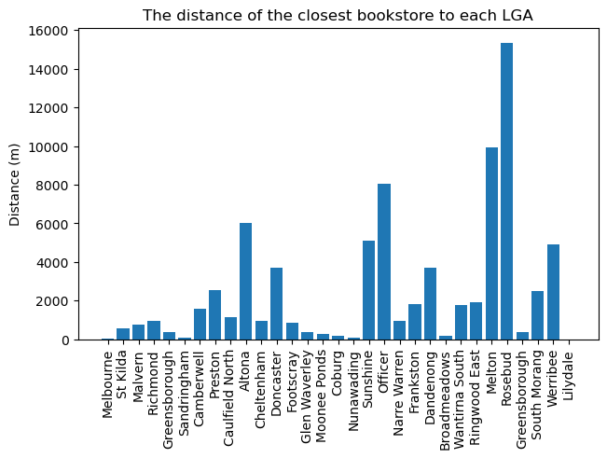
Bookstore density and the distance of the closest bookstore indicated possible local region for new bookstore

Slide 11
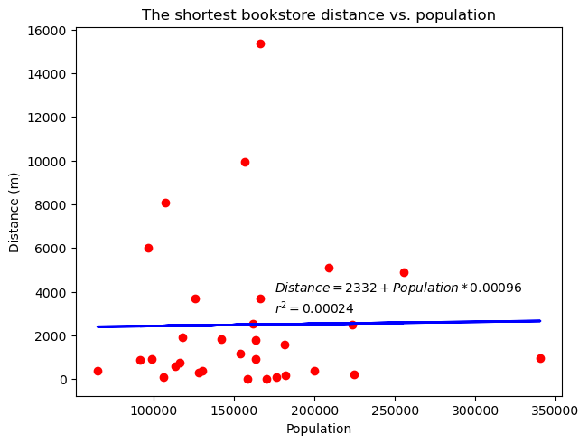
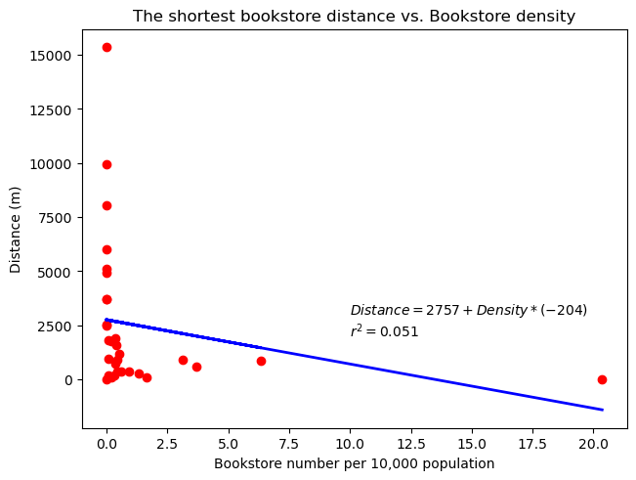
No correlation was found between the selected variables

Slide 12
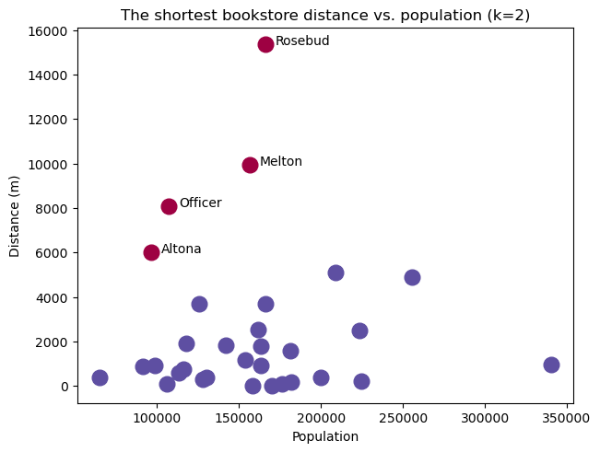
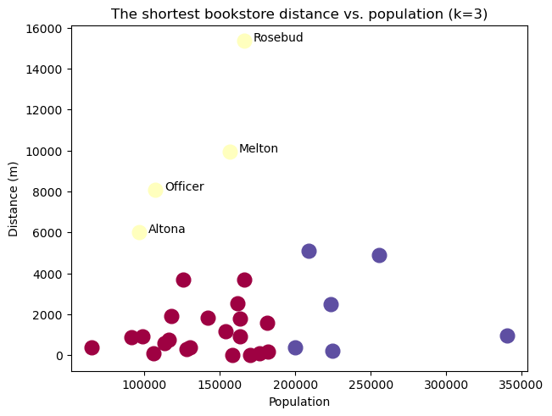
K-Means clustering(k=2-5) results indicated a clearly necessity for a new book store in certain local regions

Slide 13
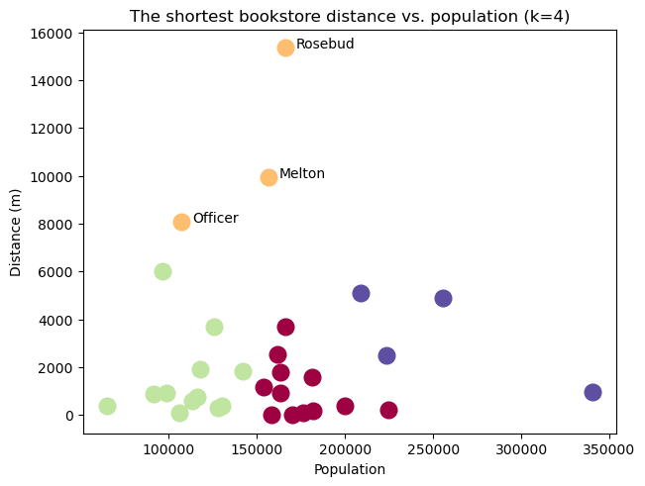
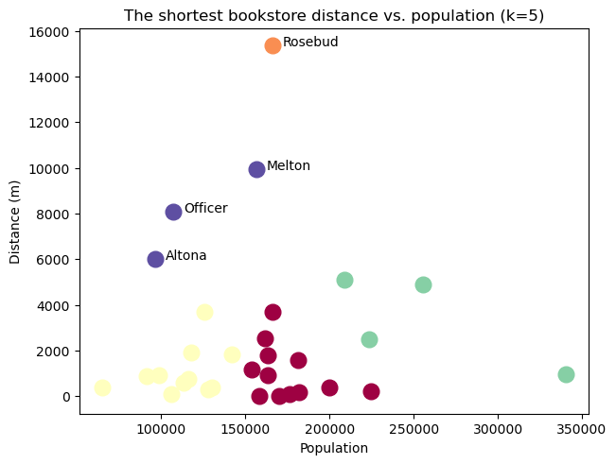

Slide 14
Discussion
Based on the previous study, the local government are of Rosebud, Melton, Officer, and Altona, could be selected as the possible locations for a new bookstore. Whether to setup a new one, might be considered with other factors, which were not studied here.
The method used in the current study was relatively simple. There might be several ways to refine the study. For example, in the current study, only the center of the LGA was considered. If the study was finer, a few more locations in an LGA should be considered. Also, the population was not segmented, while it should be done for a finer study.
Regarding the tools and packages used in the current study, Foursquare and machine learning packages were extremely powerful and should be studied deeply for a finer future study.

